Slide 1

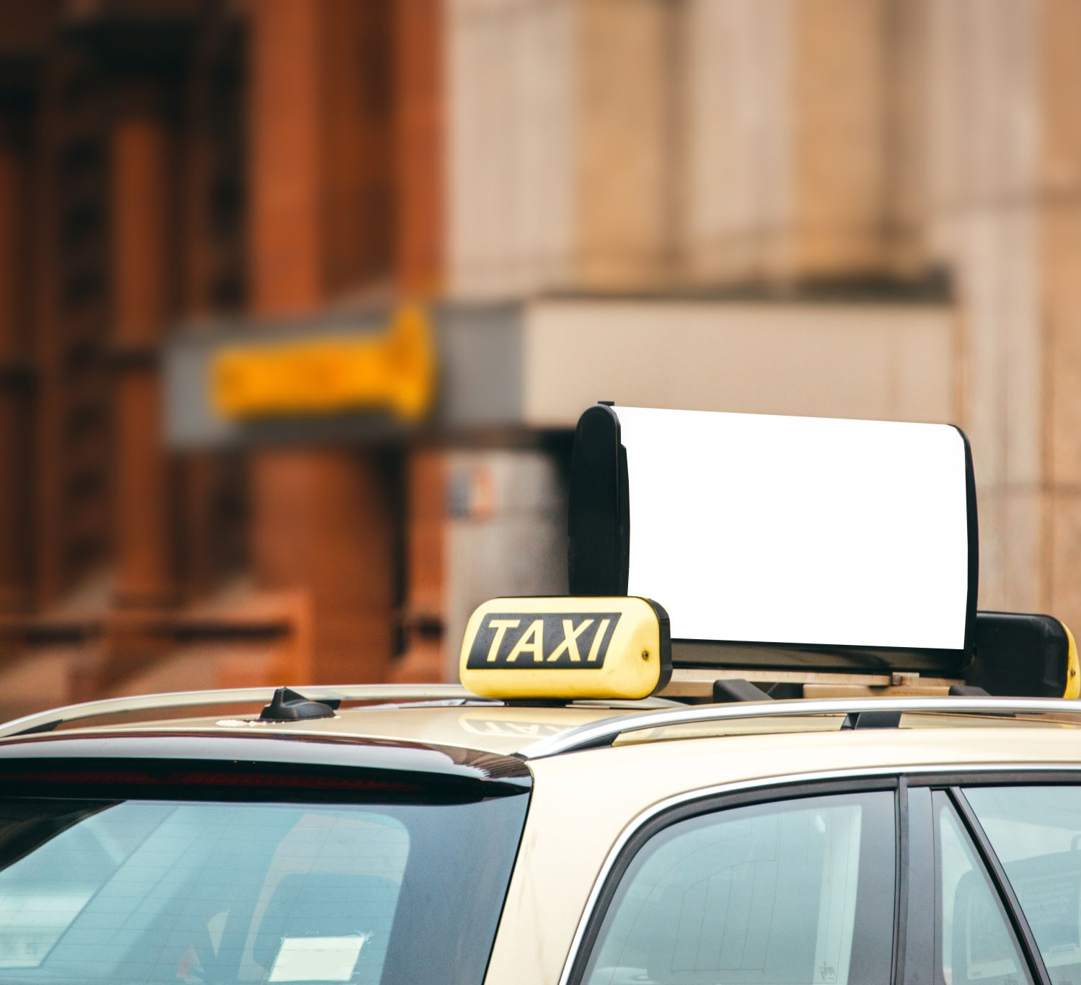
Taxi Fare Prediction Using Regression Models
Akhilesh Reddy Erravally (700745558)
Prabhu Kumar Dharanikota
(700715889)

Slide 2
Role/Responsibilities and Contribution in project
Develop and implement machine learning models for taxi fare prediction using Python and relevant libraries like Scikit-learn, Tensorflow, and Keras.
Conduct data preprocessing and feature engineering to prepare the data for model training and evaluation.
Evaluate model performance, and fine-tune model parameters to optimize the prediction accuracy.
Collaborate with data engineers to ensure data quality, reliability, and integrity.
Design and implement data pipelines to ingest, process, and store the taxi ride data
Collaborate with team engineers to ensure that the data is suitable for training and evaluation of machine learning models.

Slide 3

Motivation
In recent years, a number of new taxi services have emerged, including Uber, Ola, Meru Cabs, and others. And every day, these taxi companies provide service to tens of thousands of customers.
It is now very necessary for them to appropriately manage their data in order to generate original ideas for their organization and obtain the best possible results.
As a consequence of this, having an accurate forecast of the fares is of the utmost importance.

Slide 4
Objectives
Analyze and explore the data using scientific packages in python.
Remove noise data, missing values and outliers in the data.
Select the most features that effecting the target variable.
Creating regression models tuning the model to get good results.
Comparing different models and choose the best model for the results.

Slide 5
Related Work:
The data that are kept in an archive are accessed by predictive analysis so that it may generate predictions about events that will take place farther in the future.
A mathematical model is developed as an input using the historical data, and its goal is to discover noteworthy patterns in the data.
After then, the model takes use of the data that is already accessible in order to create predictions for the further term or to derive actions that need optical results.

Slide 6
Related Work
In recent years, a number of new taxi services have emerged, including Uber, Ola, Meru Cabs, and others.
every day, these taxi companies provide service to tens of thousands of customers. It is now very necessary for them to appropriately manage their data in order to generate original ideas for their organization and obtain the best possible results.
In this model They used machine learning technique of linear Regression model, and it may contain labelled data. Here the methodology and outcomes of this work can contribute to a more real-world demand.
This application can improve the transport accessibility, reduce waiting time and reduce the transportation fare etc.

Slide 7
Related Work
For the purpose of forecasting occurrences farther in the future, predictive analysis makes use of data that is stored in an archive.
Using the historical data as input, a mathematical model is constructed in order to identify significant patterns.
After that, the model makes use of the data that is now available to make predictions for the further term or to develop actions that need optical outcomes.

Slide 8
Problem Statement
The data that are kept in an archive are accessed by predictive analysis so that it may generate predictions about events that will take place farther in the future. A mathematical model is developed as an input using the historical data, and its goal is to discover noteworthy patterns in the data.
After then, the model takes use of the data that is already accessible in order to create predictions for the further term or to derive actions that need optical results.
Those forecasts and actions are based on the data that is currently available.
The field of predictive analytics has had a renaissance of interest in recent years, mostly as a result of the advancements that have been achieved in supporting technologies within large data and machine learning.

Slide 9
Problem Solution
We have used 3 error metrics for evaluation.
• Root Mean Square Error
• Mean Squared Error
• R2 Score
We have tried the following algorithms:
• Linear Regression
• Decision Trees
• Random Forest Regression
• XGB Regressor (without any hyperparameter Tuning) and
• XGB with Hyperparameters

Slide 10
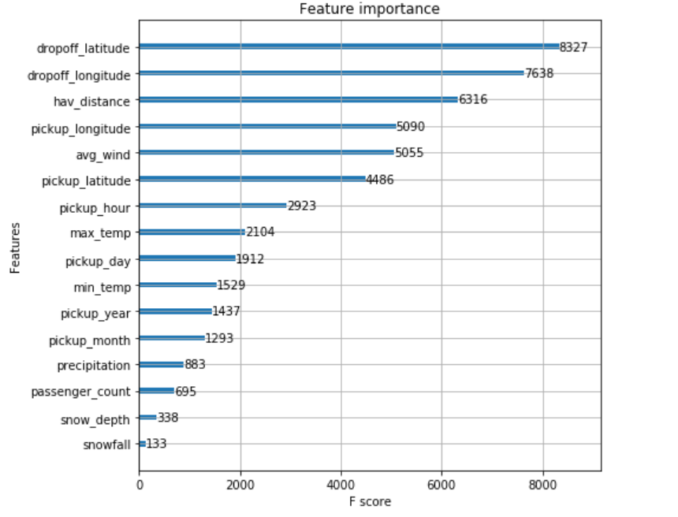
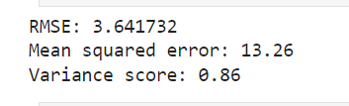
Results and Simulation
The XGB with gave us best results with hyperparameter tuning.
Feature Importance from the dataset shows which features are more considered for determining target variable.

Slide 11
Reference
B. W. D. R. F. &. S. F. Ning, "Predicting Taxi Demand and Fare Rates Using Long Short-Term Memory Networks," IEEE Transactions on Intelligent Transportation Systems, vol. 20(10), pp. 3757-3766, 2019.
Y. Z. Q. &. C. B. Ma, "Taxi Fare Prediction Based on Gradient Boosting Decision Tree Algorithm," Journal of Advanced Transportation,, vol. 8852492, 2020.
L. S. Z. C. Y. L. J. &. L. H. Zhang, "A Multimodal Learning Approach for Taxi Demand and Fare Prediction," IEEE Transactions on Intelligent Transportation Systems, pp. 1-12, 2021.
R. M. B. M. J. &. A. J. P. De Sousa, "A Methodology for Taxi Demand Prediction Using Stream Learning.," IEEE Access, no. 7, pp. 63271-63282, 2019.
T. &. H. J. Chen, "Refined Taxi Demand Prediction with ST-Vec," IEEE Transactions on Intelligent Transportation Systems, vol. 22(7), pp. 4268-4277, 2020.
Y. C. Y. &. C. Y. Liu, "Improving prediction for taxi demand by using machine learning," Journal of Advanced Transportation, pp. 1-13, 2018.
Wei, Z., Zhang, Y., & Liu, X. (2018). Deep learning-based taxi fare prediction in New York City. IEEE Transactions on Intelligent Transportation Systems, 19(3), 809-818.
Choi, J., Lee, D., Lee, J., & Kim, K. (2018). A deep learning approach to taxi demand prediction in New York City. IEEE Access, 6, 56562-56570.

